Slide 1
H E A R T F A I L U R E
M O R T A L I T Y P R E D I C T I O N
A S S I G N M E N T 8

Slide 2
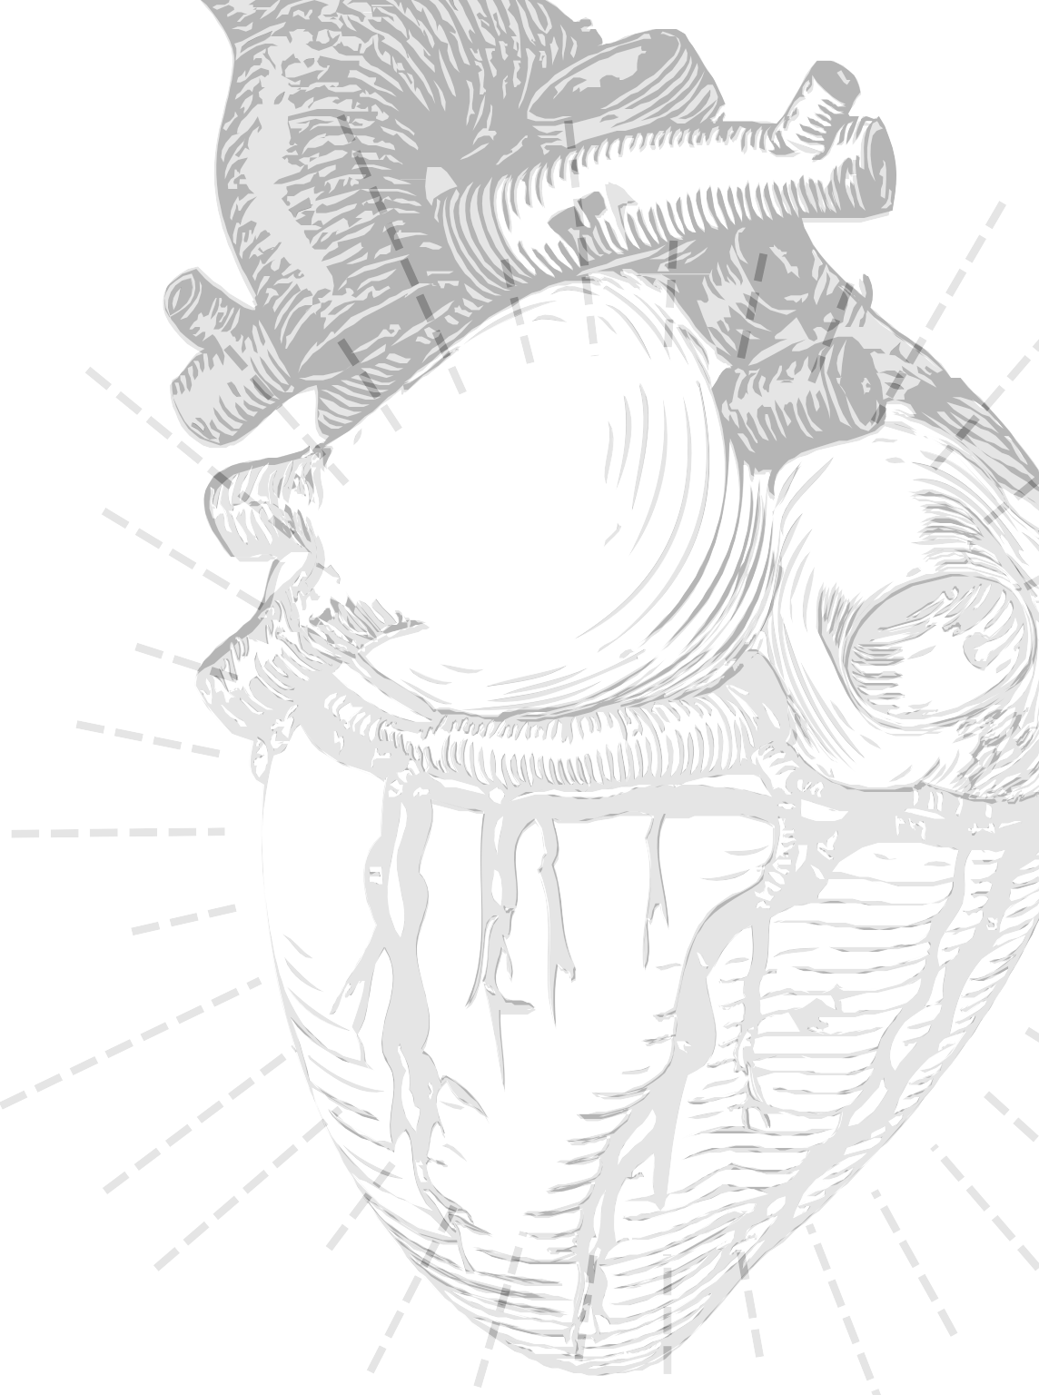
Agenda
Problem vs solution
Get & Explore data
Prepare data
Shortlist Models

Slide 3
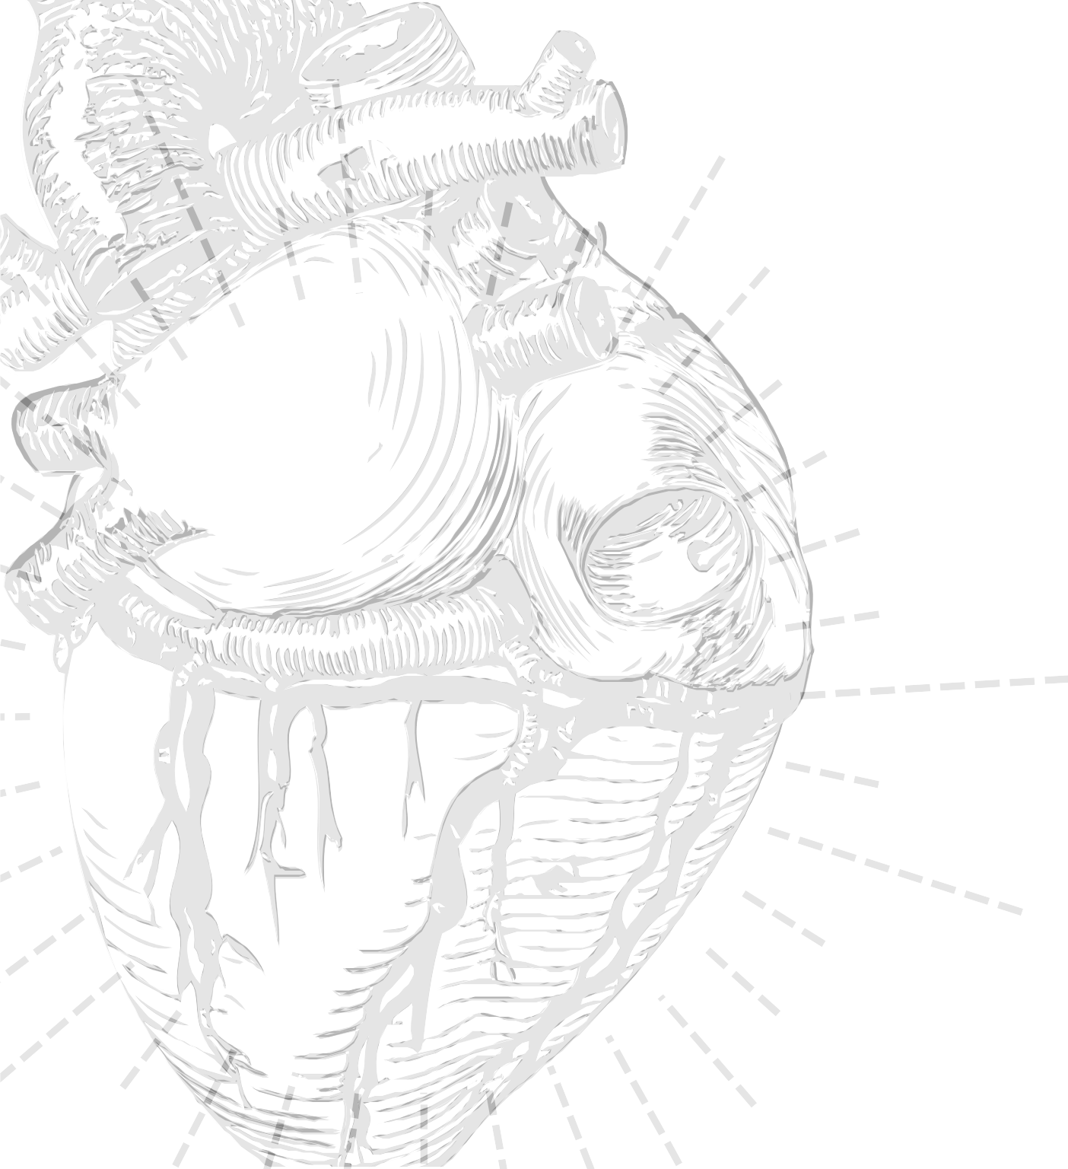
H E A R T F A I L U R E
C l i n i c a l s y n d r o m e
c o n s i s t i n g o f c a r d i n a l
s y m p t o m s ( b r e a t h l e s s n e s s , a n k l e s w e l l i n g , a n d f a t i g u e)
M a y b e a c c o m p a n i e d b y s i g n s ( e l e v a t e d j u g u l a r
v e n o u s p r e s s u r e , p u l m o n a r y c r a c k l e s , a n d p e r i p h e r a l
o e d e m a )

Slide 4

H E A R T F A I L U R E
I d e n t i f y i n g t h e u n d e r l y i n g c a u s e o f c a r d i a c d y s f u n c t i o n i s c r u c i a l f o r p r o p e r t r e a t m e n t
T r e a t m e n t o p t i o n s m a y i n c l u d e m e d i c a t i o n , l i f e s t y l e c h a n g e s , a n d
i n s e v e r e c a s e s , s u r g e r y .

Slide 5
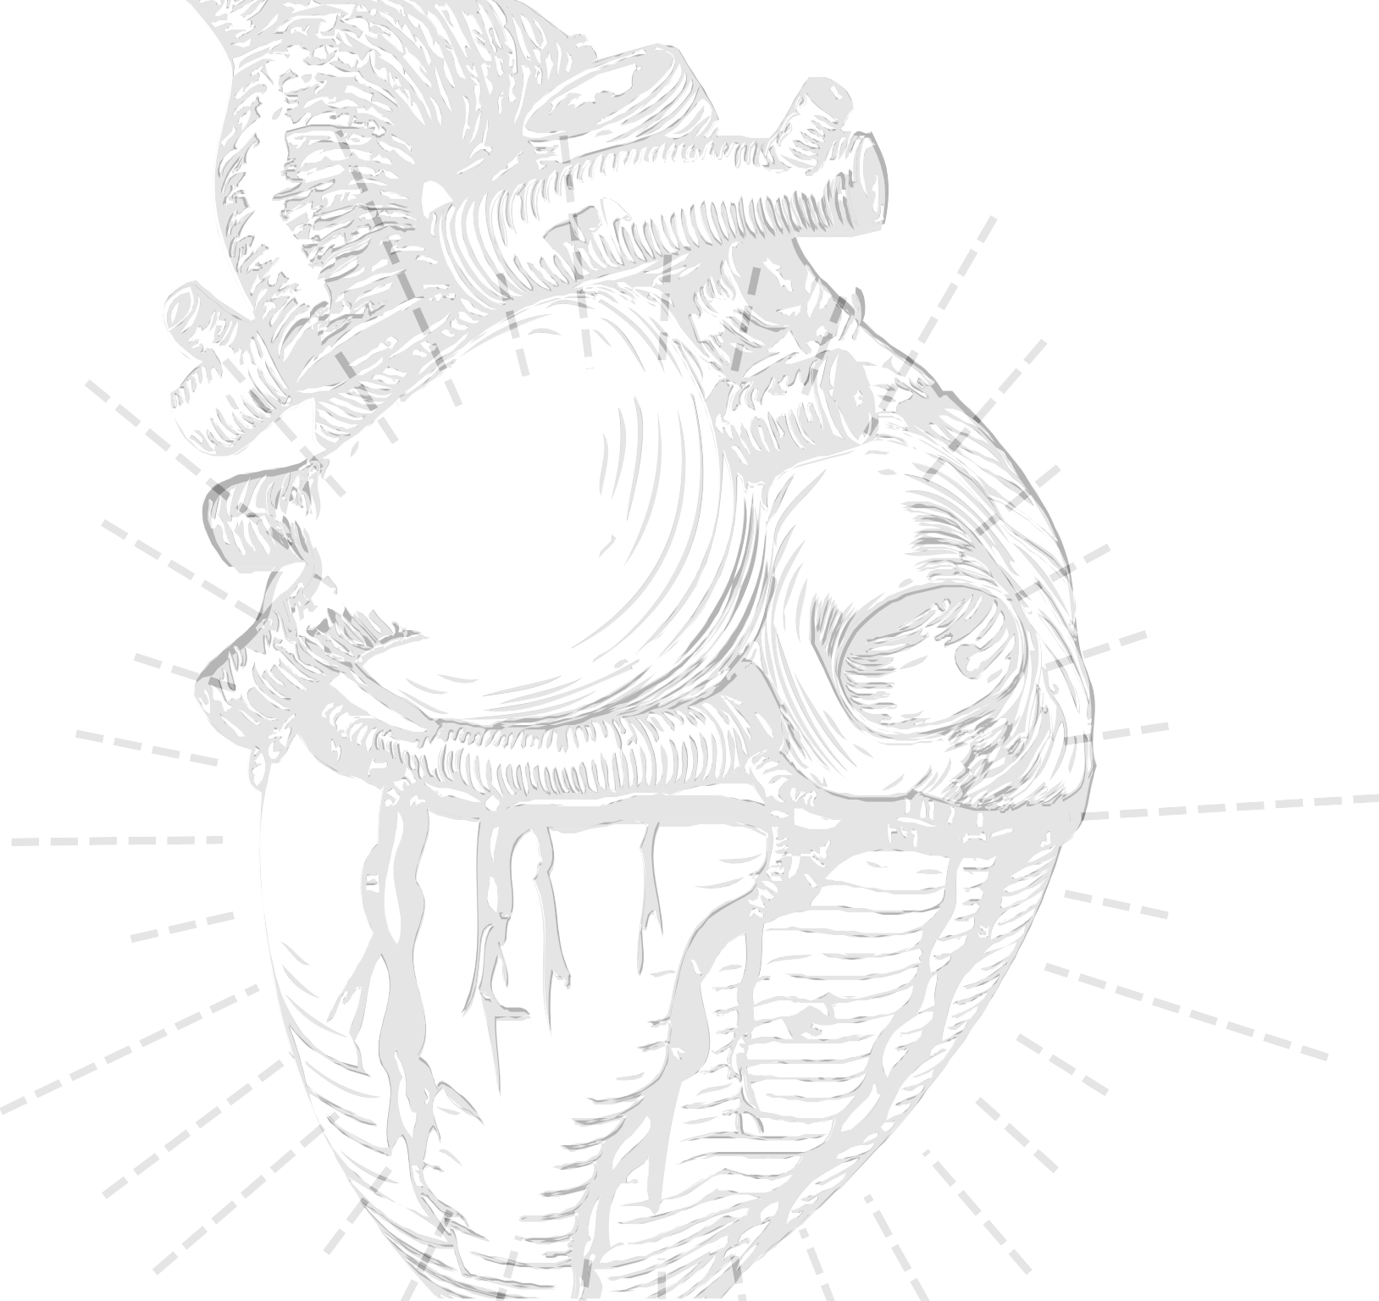
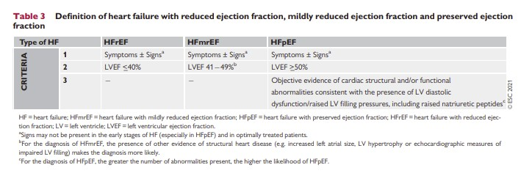
T E R M I N O L O G Y
3 d i s t i n t i c c r i t e r i a o f h e a r t f a i l u r e b a s e d o n l e f t v e n t r i c u l a r e j e c t i o n f r a c t i o n
50%
50%

Slide 6
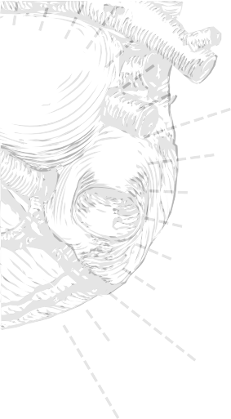
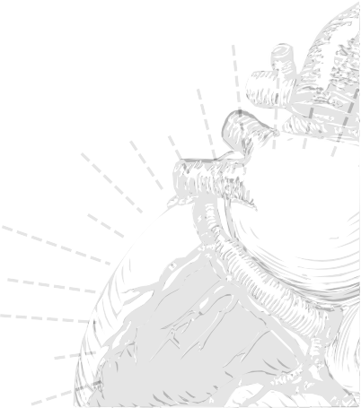
2%
o f a d u l t s h a v e H e a r t F a i l u r e
1 0 % o f t h o s e > 7 0 y e a r s

Slide 7
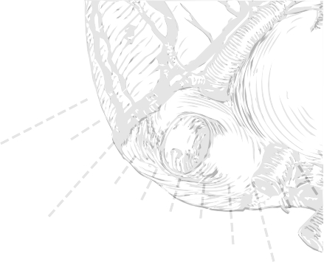
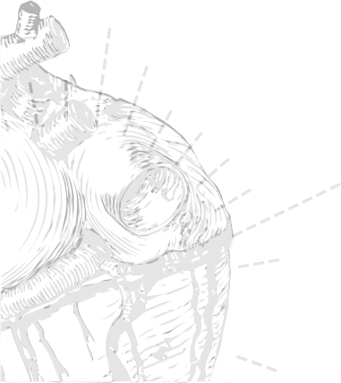
H E A R T F A I L U R E
1
h o s p i t a l i z e d o n c e e v e r y y e a r
1.5x
h i g h e r h o s p i t a l i z a t i o n s w i t h p a t i e n t w i t h d i a b e t e s

Slide 8
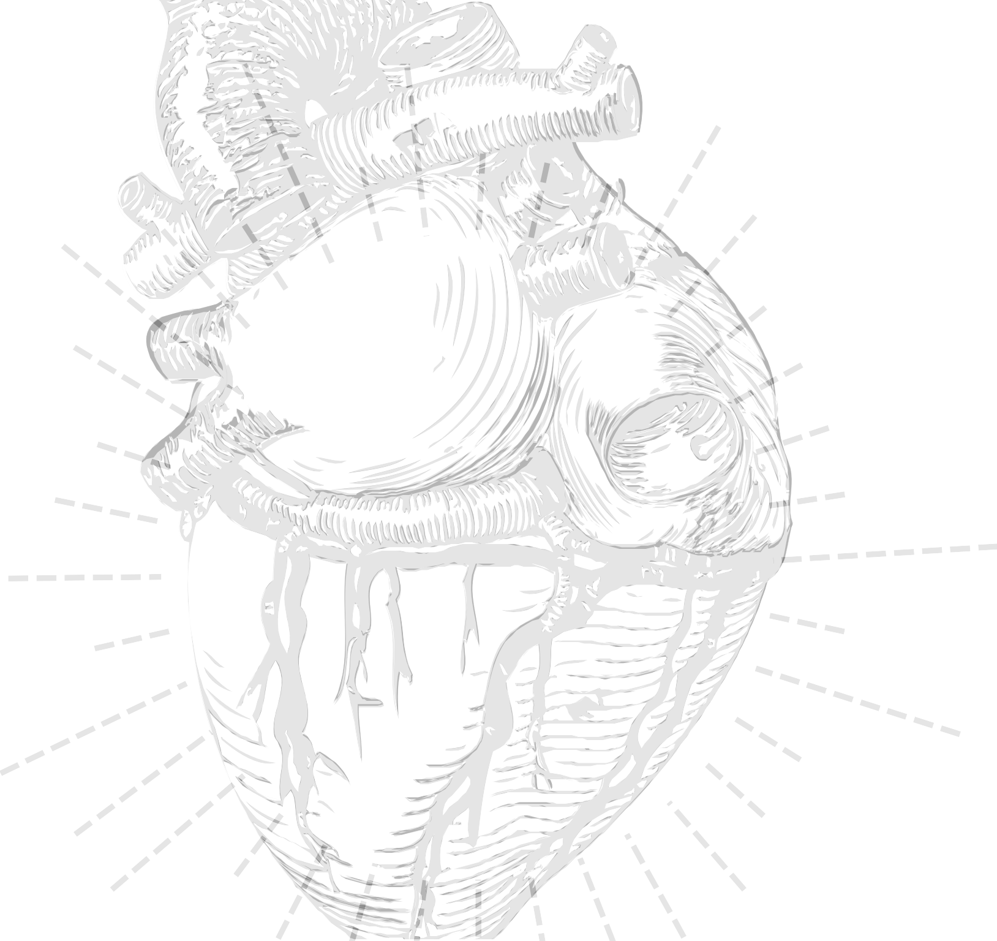
C O U L D W E M O D E L Y O U R R I S K O F M O R T A L I T Y D U E T O H E A R T F A I L U R E ?
Basic Descriptive Statistics
Neural Networks:
The Multilayer Perceptron and backpropagation

Slide 9
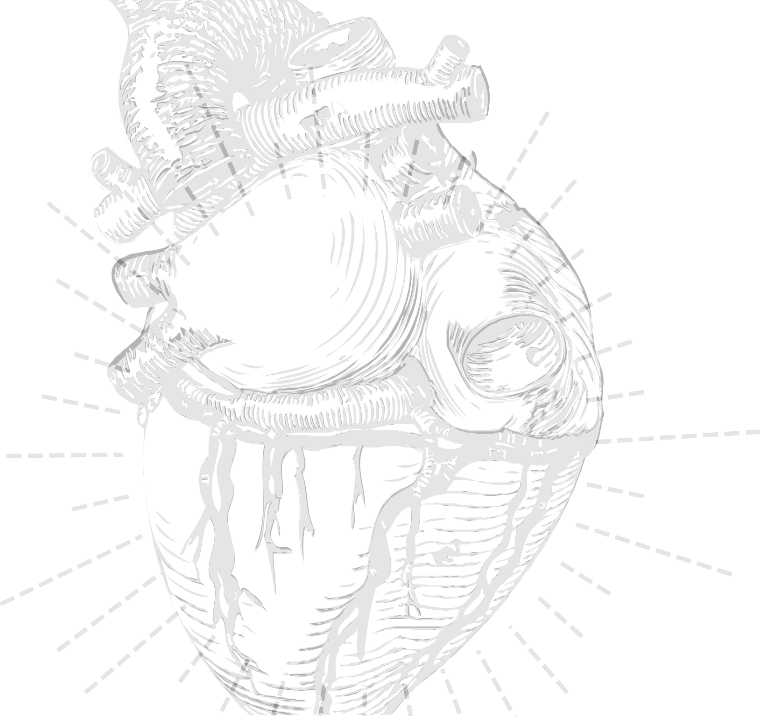
E X T R A C T | E X P L O R E

Slide 10

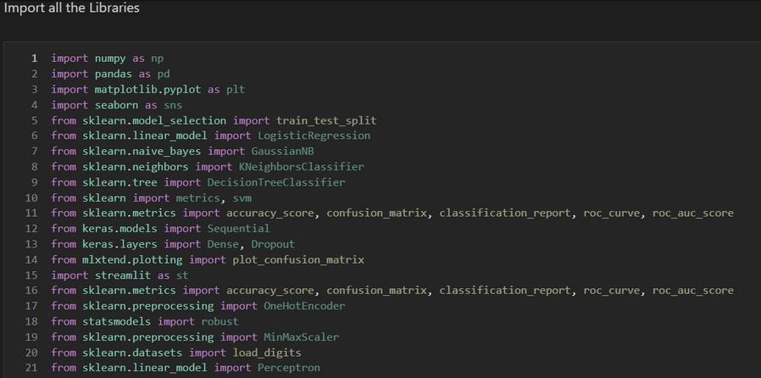
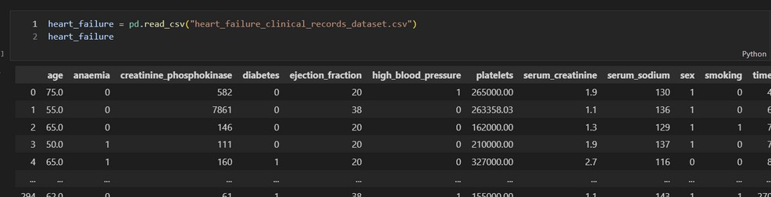
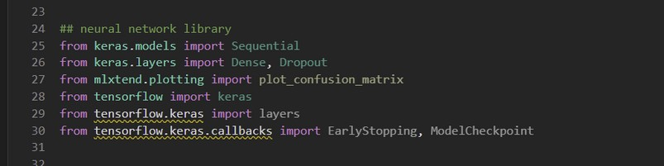

Extract and Explore

Slide 11
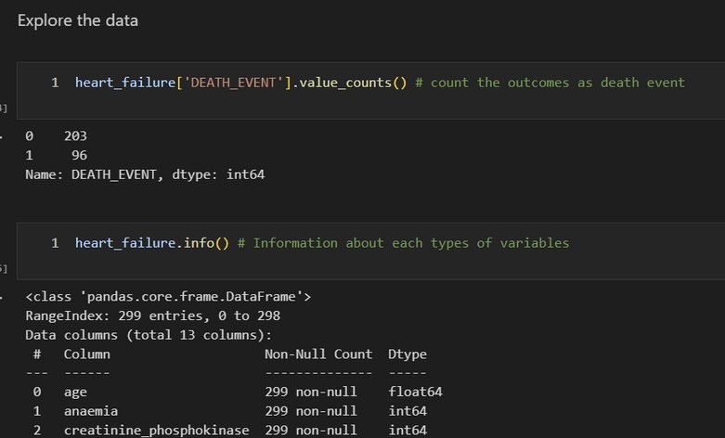
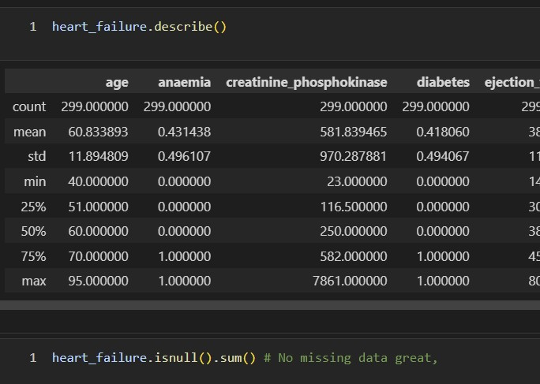
Explore & Missing Data

Slide 12
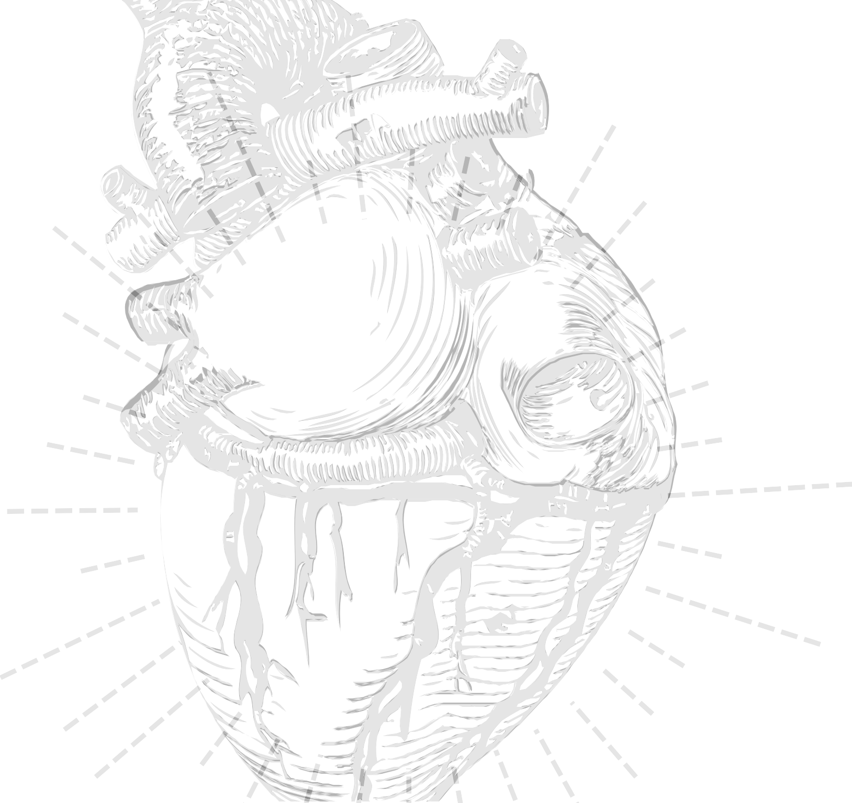
D E S C R I P T I V E S T A T I S T I C S

Slide 13
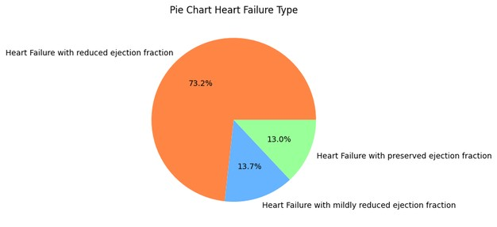
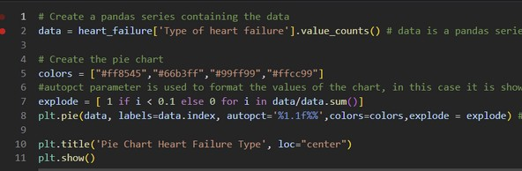
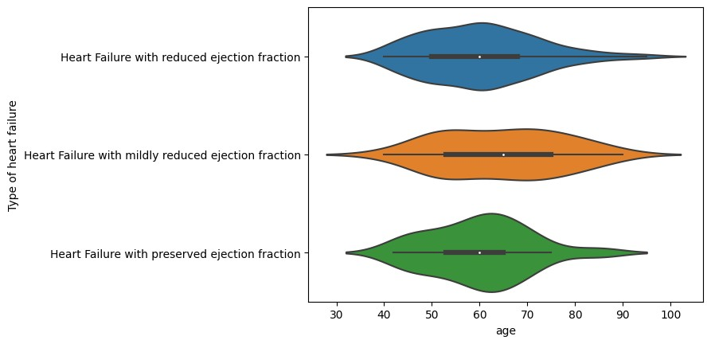

Descriptive Statistics

Slide 14
N E U R A L N E T W O R K S

Slide 15

V A R I A B L E P R E P A R A T I O N
O n e _ H o t e n c o d i n g f o r c a t e g o r i c a l
v a r i a b l e
N o r m a l i z e d a t a ?
N u m e r i c a l V a r i b l e s ?
M i n M a x S c a l e r ( C r e a t i n i n e & P l a t e l e t s )
M e a n A b s o l u t e d e v i a t i o n

Slide 16
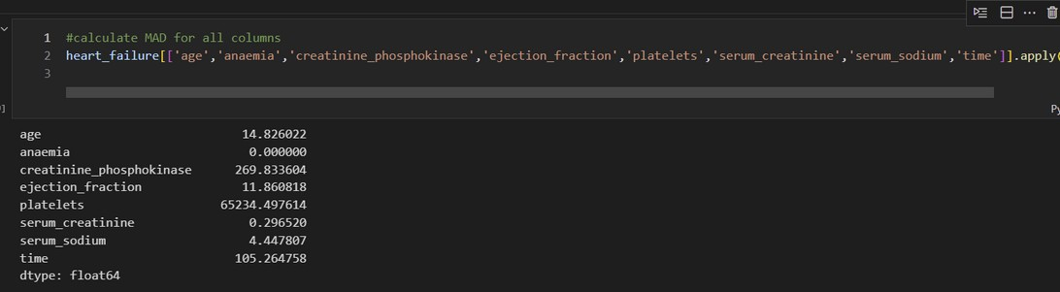
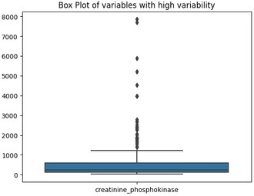
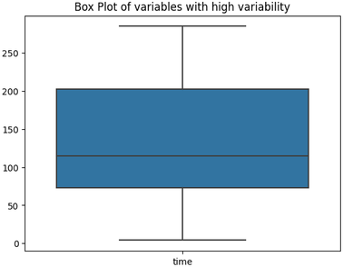
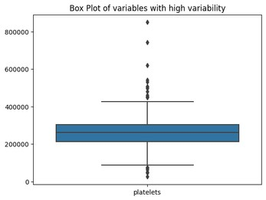
MAD

Slide 17

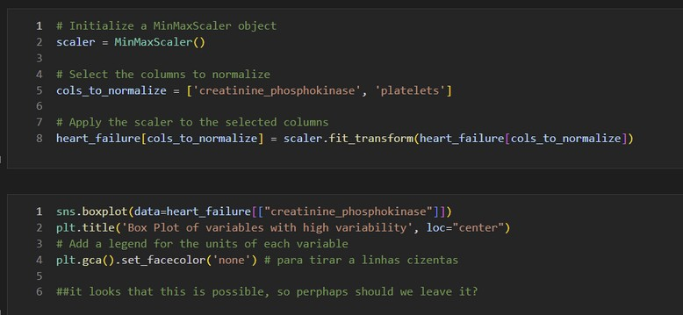
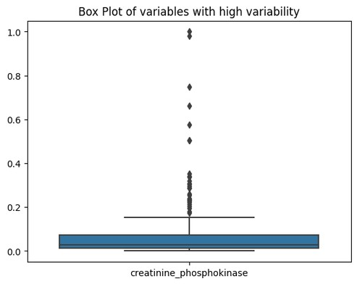
Min Max Scaler as don't impact outliers

Slide 18
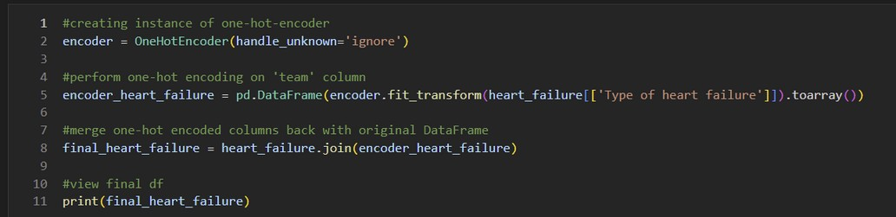
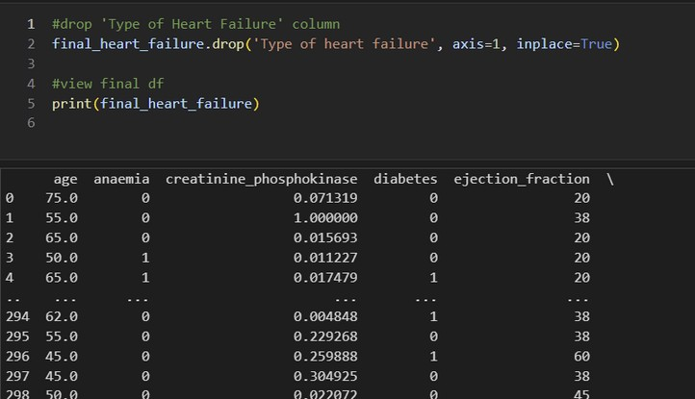
Hot Encoding for Categorical variables

Slide 19
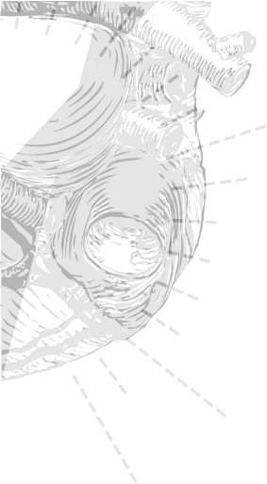
Hot Encoding for Categorical variables

Slide 20
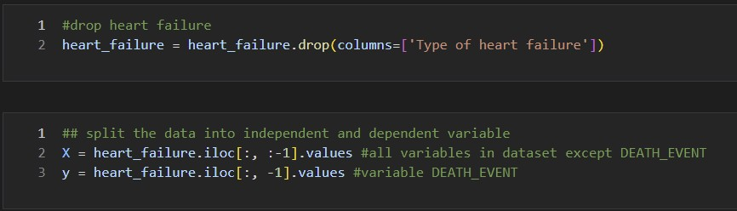
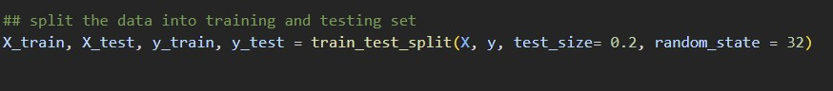
Neural Network: split data

Slide 21
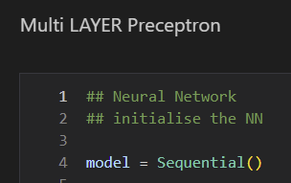
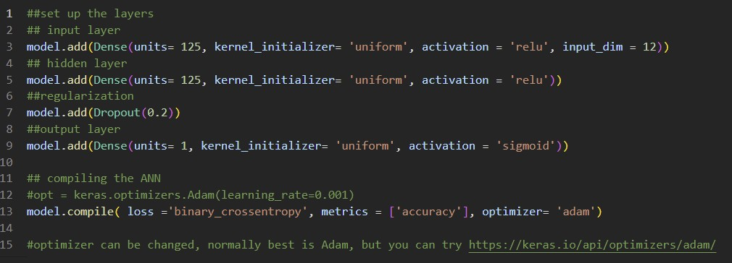
Neural Network: layer setup

Slide 22
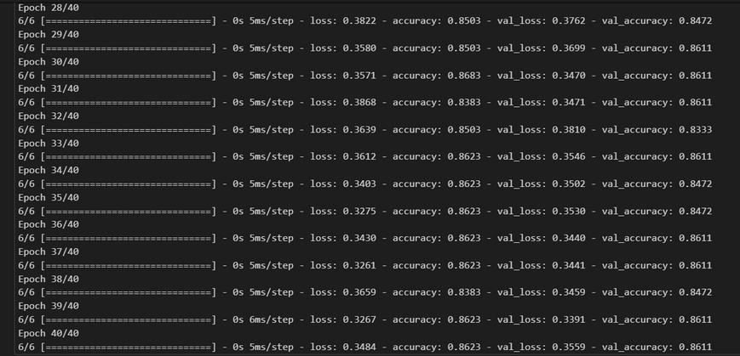
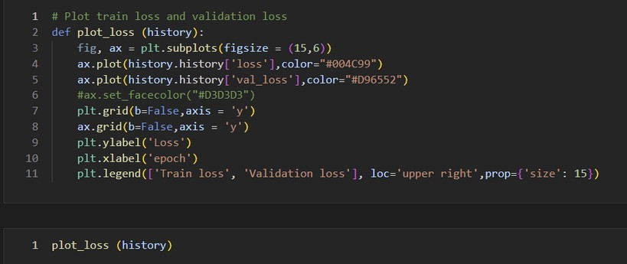
Neural Network

Slide 23
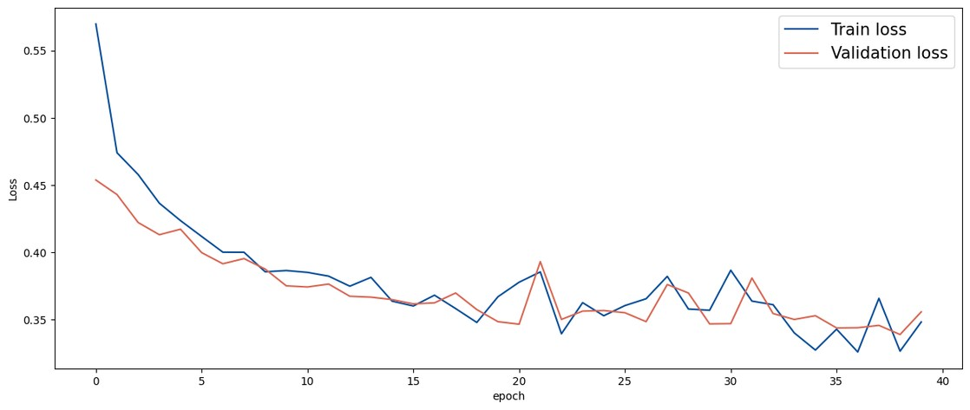
Neural Network

Slide 24
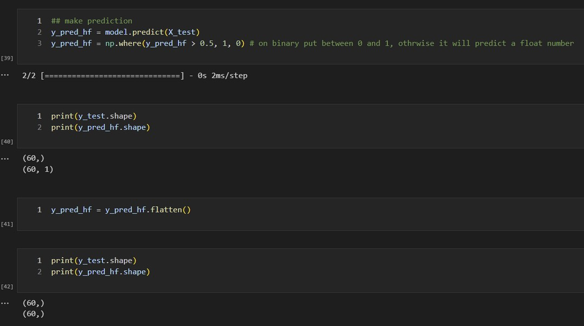
Neural Network: make a prediction

Slide 25
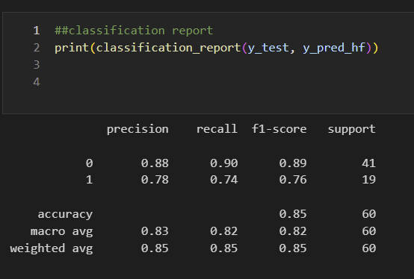
Neural Network: classification report

Slide 26
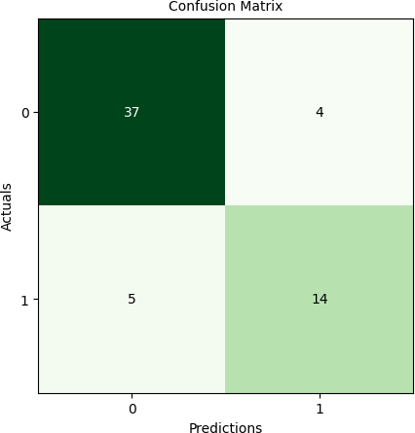
Neural Network: Confusion Matrix

Slide 27
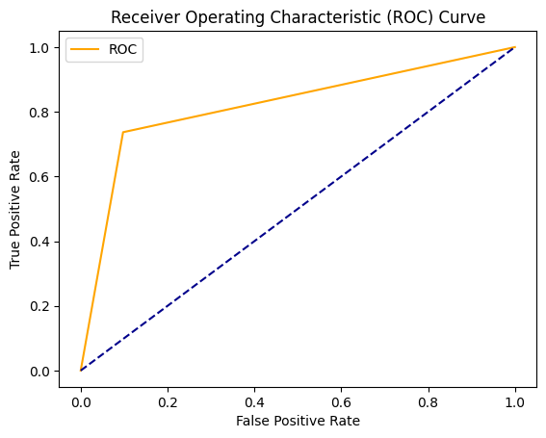
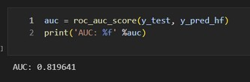
Neural Network: ROC Curve

Slide 28
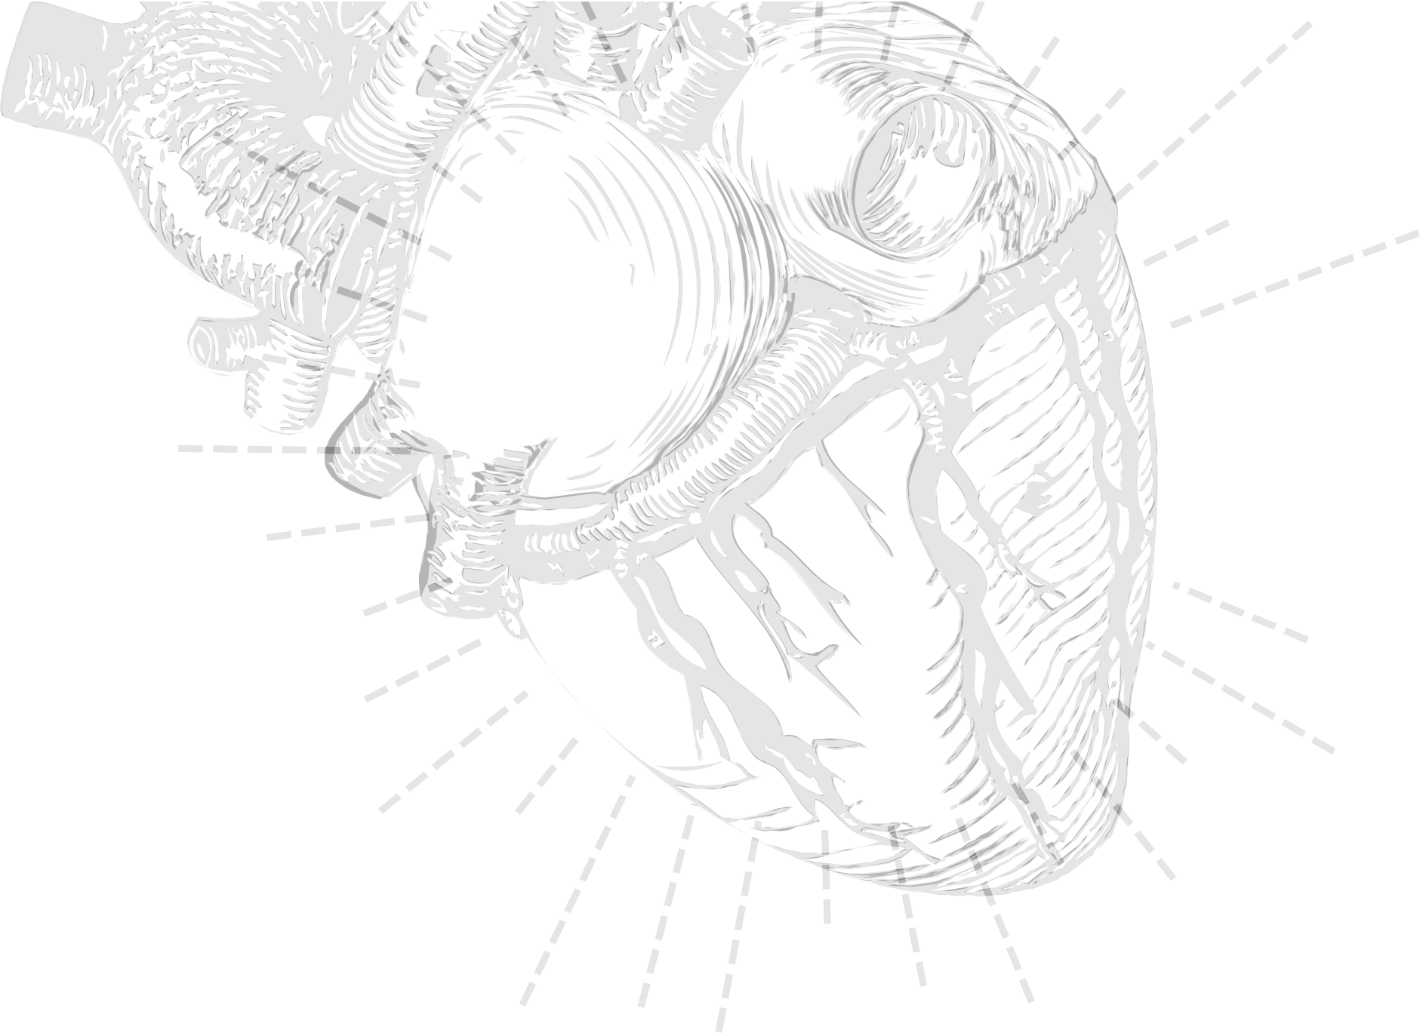
C O N C L U S I O N
F i n d a w a y t o l e a v e t y p e s o f H e a r t f a i l u r e a n d s e e i f t h i s i m p r o v e s m y a c c u r a c y .
6 0 % o f t h e t i m e w a s s p e n t o p t i m i z i n g n e u r a l n e t w o r k s .
R e a d i n g t h e b o o k : m a d e m e u n d e r s t a n d h o w t h e m o d e l w o r k s a n d m a k e m o r e i n s i g h t f u l q u e s t i o n s .
S t a rt e a r l y !

